Slide 1
MECHANISM OF URINE FORMATION

Slide 2
The process of urine formation is known as uropoeisis.
Urine formation is the physiological process through which the kidneys filter blood to get rid of waste
materials and excess substances and keep the body’s fluid and electrolyte balance.
It is an important process in the human body, is responsible for eliminating waste and maintaining a
balance of many components required for overall health.
Urine production is a vital part of the excretory system that involves different stages that enable the elimination of metabolic wastes, excess water and electrolytes from the bloodstream.

Slide 3
Urine is a watery or semi-solid concentration of waste generated by both humans and animals as a result of physiological processes.
It also contains hazardous substances produced by excretory organs during fluid circulation.
Urine is one of the waste products that the human
body routinely excretes.
Kidneys are essential to the elimination process.
Both organic and inorganic chemicals can be found in urine. Urine can contain organic compounds such as urea, creatinine and uric acid. Chloride, sodium, and potassium are examples of inorganic solutes.

Slide 4
Its acidic pH of about 6 is caused by the presence of proteins.
In healthy people, urobilin is primarily responsible for the color of the urine.

Slide 5
Physiology / mechanism of Urine formation
There are three stages involved in the process of urine formation. They are:
Glomerular filtration or ultra-filtration
Selective reabsorption
Tubular secretion

Slide 6
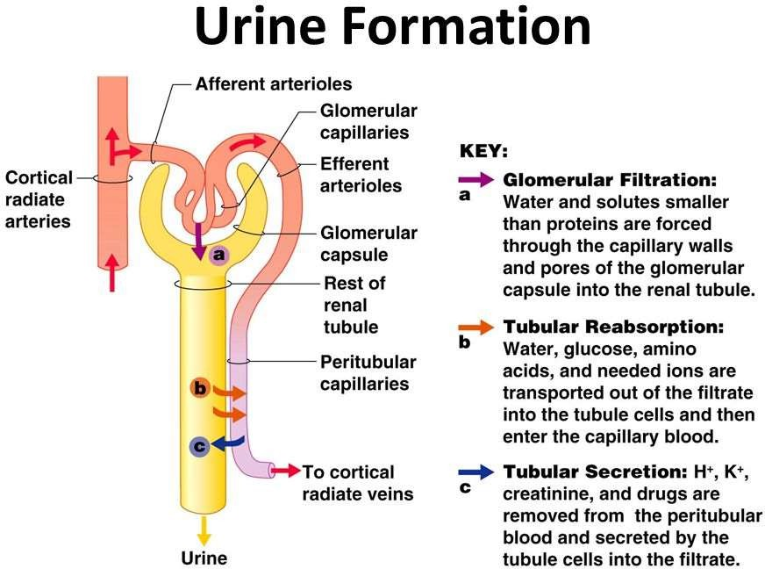

Slide 7
Glomerular filtration
The initial stage in the mechanism of urine formation is glomerular filtration
This takes place through the semipermeable walls of the glomerular capillaries and Bowman’s capsule.
The afferent arterioles supplying blood to glomerular capsule carries useful as well as harmful substances. The useful substances are glucose, amino acids, vitamins, hormones, electrolytes, ions etc and the harmful substances are metabolic wastes such as urea, uric acids, creatinine, ions, etc.
The diameter of efferent arterioles is narrower than afferent arterioles. Due to this difference in diameter of arteries, blood leaving the glomerulus creates the pressure known as hydrostatic pressure.

Slide 8
The glomerular hydrostatic pressure forces the blood to leaves the glomerulus resulting in filtration of blood.
A capillary hydrostatic pressure of about 7.3 kPa (55 mmHg) builds up in the glomerulus. However this pressure is opposed by the osmotic pressure of the blood, provided mainly by plasma proteins, about 4 kPa (30 mmHg), and by filtrate hydrostatic pressure of about 2 kPa (15 mmHg in the glomerular capsule.
The net filtration pressure is = Therefore: 55 - (30 +15) = 10mmHg.

Slide 9
By the net filtration pressure of 10mmHg, blood is filtered in the glomerular capsule.
Water and other small molecules readily pass through the filtration slits but Blood cells, plasma proteins and other large molecules are too large to filter through and therefore remain in the capillaries.
The filtrate containing large amount of water, glucose, aminoacids, uric acid, urea, electrolytes etc in the glomerular capsule is known as nephric filtrate of glomerular filtrate.
The volume of filtrate formed by both kidneys each minute is called the glomerular filtration rate (GFR). In a healthy adult the GFR is about 125 mL/min, i.e. 180 litres of filtrate are formed each day by the two kidneys

Slide 10
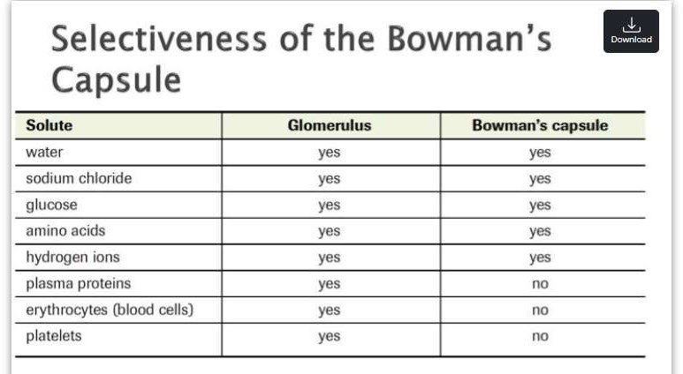

Slide 11
Selective reabsorption
Reabsorption of some substance is passive, while some substances are actively transported. Major portion of water is reabsorbed by Osmosis.
The proximal convoluted tubule (PCT), a Henle loop, and the distal convoluted tubule (DCT) are where almost all of the reabsorbing process in the kidney happens.
The Proximal Convoluted Tubule (PCT):
The majority of reabsorption occurs in the proximal convoluted tubules.
As the filtrate passes to the renal tubules, useful substances including some water, electrolytes and organic nutrients such as glucose, amino acids, vitamins hormones etc are selectively reabsorbed from the filtrate back into the blood in the proximal convoluted tubule.

Slide 12
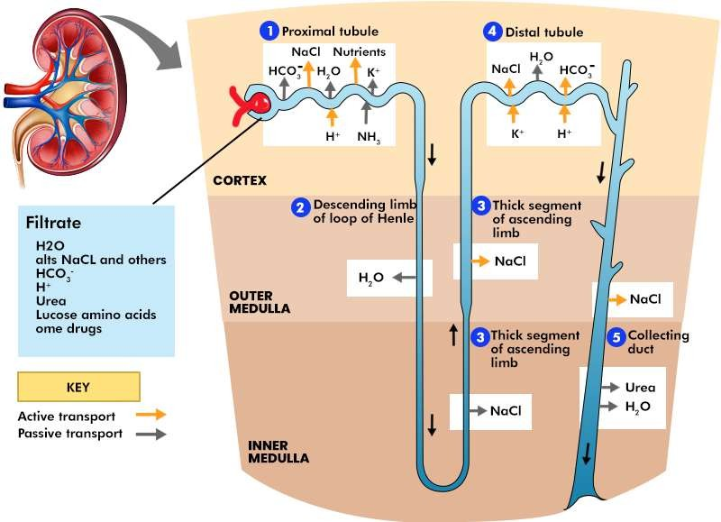

Slide 13
Loop of Henle:
Only 60–70% of filtrate reaches the Henle loop. Much of this, especially water, sodium and chloride, is reabsorbed in the loop,
The descending limb reabsorbs the remaining water. Chloride and sodium ions are reabsorbed from the ascending limb.
The Distal Convoluted Tubule (DCT):
This structure is capable of reabsorbing particular substances that have remained in the filtrate.
So that only 15–20% of the original filtrate reaches the distal convoluted tubule, More electrolytes are reabsorbed here, especially sodium, so the filtrate entering the collecting ducts is actually quite dilute.

Slide 14
Aldosterone is one of the hormones that control it. Aldosterone also controls the reabsorption of sodium ions in DCT.
Collecting ducts
The main function
of the collecting ducts is to
reabsorb as much water as the body needs.
Nutrients vitamins
such as glucose, are reabsorbed by
amino acids, and active transport.
Positive charged ions ions are also reabsorbed by active transport while negative charged ions are reabsorbed most often by passive transport. Water is reabsorbed by osmosis, and small proteins are reabsorbed by pinocytosis.

Slide 15
Tubular secretion
Tubular secretion takes place from the blood in the peritubular capillaries to the filtrate in the renal tubules and can ensure that wastes such as creatinine or excess H+ or excess K+ ions are actively secreted into the filtrate to be excreted.
Excess K+ ion is secreted in the tubules and in exchange Na+ ion is reabsorbed otherwise it causes a clinical condition called Hyperkalemia.
Tubular secretion of hydrogen ions (H+) is very important in maintaining normal blood pH.

Slide 16
Substances such as , e.g. drugs including penicillin and aspirin, may not be entirely filtered out of the blood because of the short time it remains in the glomerulus. Such substances are cleared by secretion from the peritubular capillaries into the filtrate within the convoluted tubules.
The tubular filtrate is finally known as urine. Human urine is usually hypertonic.

Slide 17
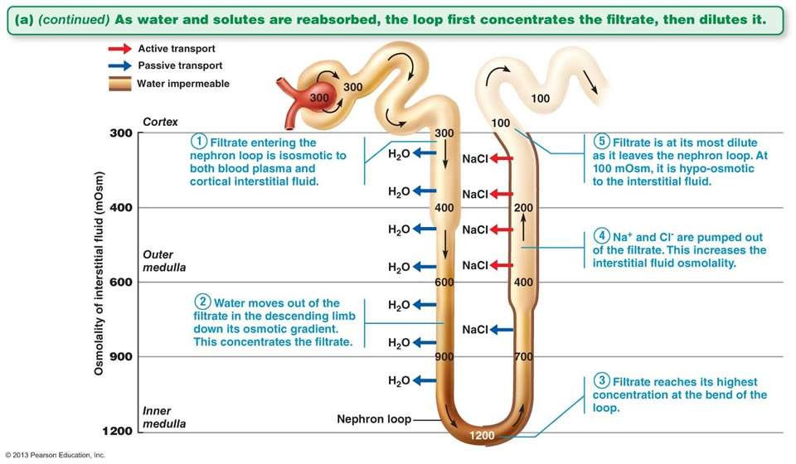

Slide 18
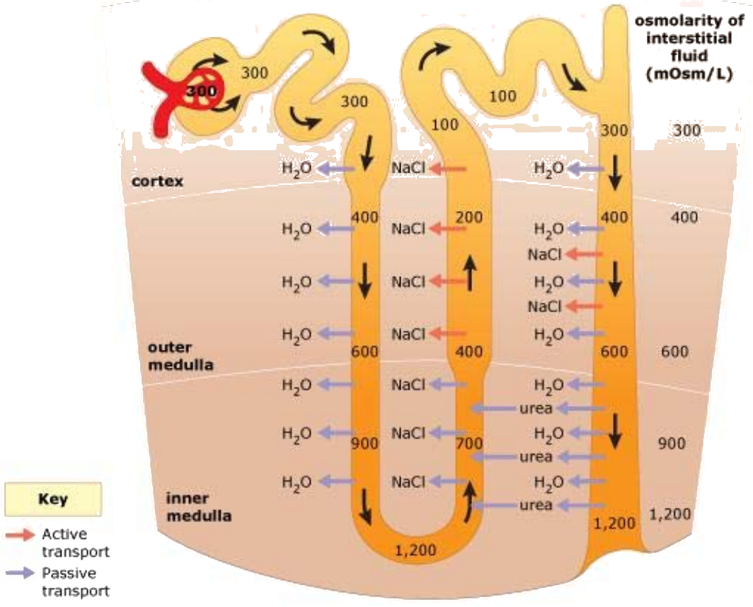

Slide 19
Composition of human urine
Water – 96%
Urea – 2%
Uric acids, creatinine, pigments- 0.3%
Inorganic salts – 2%
Bad smell is due to Urinoid
Pale yellow color due to urochrome or urobillin (which is a breakdown product of haemoglobin)
Micturation:
The process of time to time collection and removal of urine from urinary bladder is known as micturition. Collection of more than 300ml of urine in urinary bladder creates pressure on the wall. The pressure stimulates the desire for urination.

Slide 20
Significance of Urine Formation
The following are some implications of urine formation:
The production of urine aids in eliminating wastes like urea and creatinine.
It helps control extracellular fluid volume by removing extra bodily fluid.
pH is regulated by urine, which aids in removing excess acidic blood plasma components.
The kidneys maintain osmolarity or the electrolyte- water balance by concentrating or diluting the urine.

Slide 21
Urine Formation Per Day
The volume of filtrate produced by both kidneys each minute is known as the glomerular filtration rate (GFR).
Men generally create 125 mL/min of filtrate, whereas women make 105 mL/min.
Reabsorption causes 99% of the generated filtrate to return to circulation. Therefore, a healthy human body only has 1-2 litres of urine every day.

Slide 22
Conclusion
In conclusion, the formation of urine is the result of an organized set of physiological processes that take place inside the kidneys. It acts as a crucial mechanism for the management of fluid balance, electrolyte equilibrium, and waste disposal, all of which contribute to the overall health and equilibrium of the body’s internal environment.
Several steps are involved in urine formation, such as glomerular filtration, selective reabsorption, and tubular secretion. The nephron is the basic structural unit of the kidney and every nephron passes through all three phases of urine creation. First, it produces concentrated urine carried to the urinary bladder via the ureters and subsequently expelled from the body by the kidneys and other organs.

