Slide 1

Histology of Testes
Jaydeep Kumar Nath
Asst Professor
Department of Zoology
Salbari College , Baksa

Slide 2
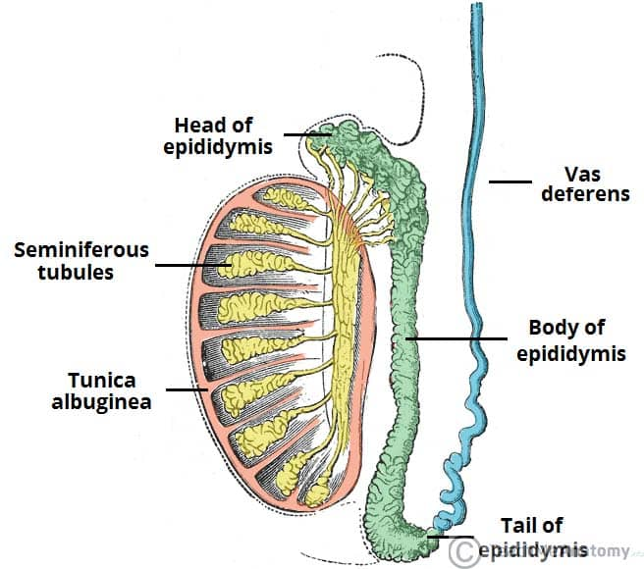
The Testes
The testes are two small organs found inside the scrotum.
Testes develop retroperitoneally on the posterior abdominal wall and descend to scrotum before birth.
The testes are responsible for making sperm and are also involved in producing a hormone called testosterone.

Slide 3
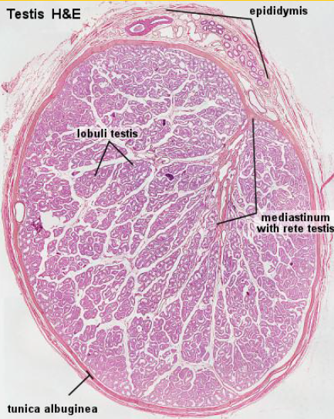
Histological Structure
The testis is surrounded by a thick capsule, the tunica albuginea, from which a conical mass of connective tissue, the mediastinum testis, projects into the testis.
From the mediastinum, delicate fibrous septa radiate towards the tunica albuginea and divide the parenchyma of the testis into about 300 lobuli testis.
Each lobule contains 1- 4 convoluted seminiferous tubules . These tubules are enclosed by a thick basal lamina and surrounded by 3-4 layers of smooth muscle cells . The insides of the tubules are lined with seminiferous epithelium, which consists of two general types of cells: spermatogenic cells and Sertoli cells.

Slide 4
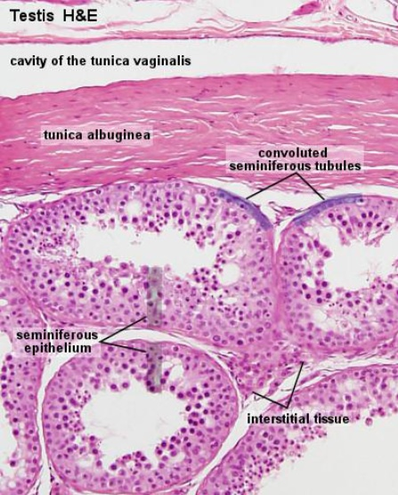
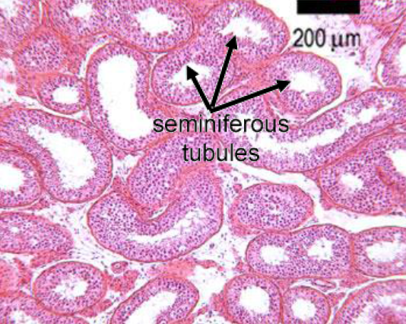

Slide 5
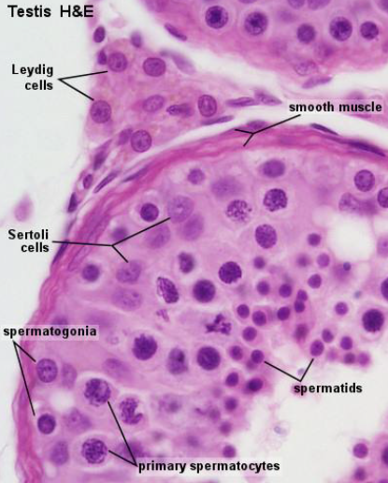
Sertoli Cells
These are slender pyramidal cells standing at intervals on the basal lamina present on the inner surface of fibrous sheath. The germinal cells are crowded between the sertoli cells. The function of Sertoli cells is to support and nourish the developing spermatozoa and the germinal cells.

Slide 6
Germinal cells/Spermatogenic Cells
The germ cells or sex cells make up a stratified layer of 4 to 8 cells deep. The cells differentiate progressively , from periphery to lumen.
Germ cells nearest the lumen transform into spermatozoa which detach as motile cells. This sequence of events is known as spermatogenesis.

Slide 7
Next to the basal lamina lie the spermatogonia , these have clear cytoplasm with their nuclear chromatin usually appearing as a network.
Following the spermatogonia are the spermatocytes, their nuclei frequently showing active division. The outer layer of primary spermatocytes, formed from the spermatogonia, are large and spherical with big nuclei; the inner layer, formed from these by meiosis are the much smaller secondary spermatocytes.
Next to these and formed by their division, are the spermatids, appearing as several layers of small round cells with round nuclei. In some places these spermatids may be seen developing into the spermatozoa, a process known as spermotogenesis. During this differentiation, the spermatids first develop short tails and then elongate, the nucleus being situated at the head end, remote from the tail.

Slide 8
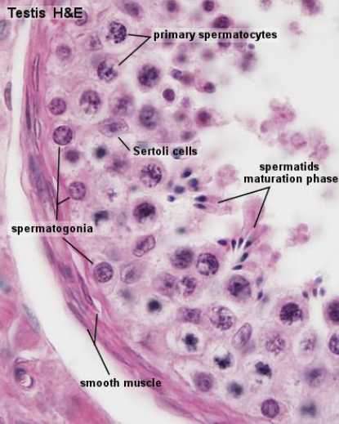
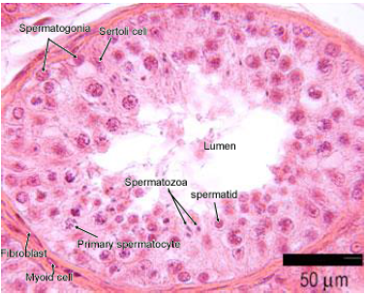

Slide 9
Interstitial Cells or Leydig Cells
The interstitial tissue or stroma fills the spaces between the seminiferous tubules. It consists of lose connective tissue with blood vessels, a lymphatic network and various kinds of cells. Fibroblasts and macrophages are always present. In addition, there are groups of specialized epithelial-like cells, the interstitial cells or "Cells of Leydig". These cells form the endocrine tissue of the testis. They secret male hormone , the androgens under the influence of pituitary leuteinizing hormone (LH)

Slide 10
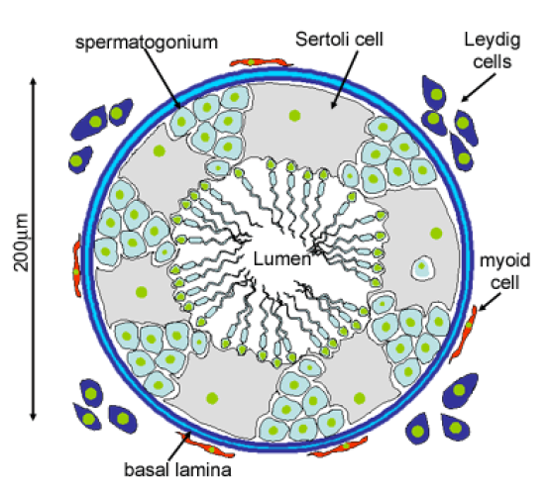

Slide 11
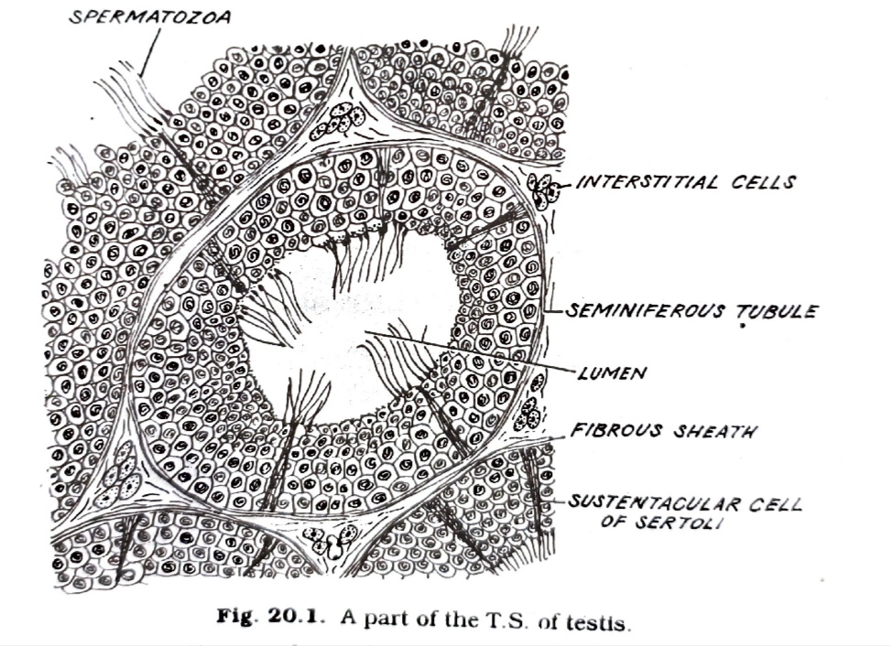

Slide 12


