Slide 1
Department of Zoology
Insect Metamorphosis
Salbari College , Salbari
Baksa , Assam , 781320

Slide 2
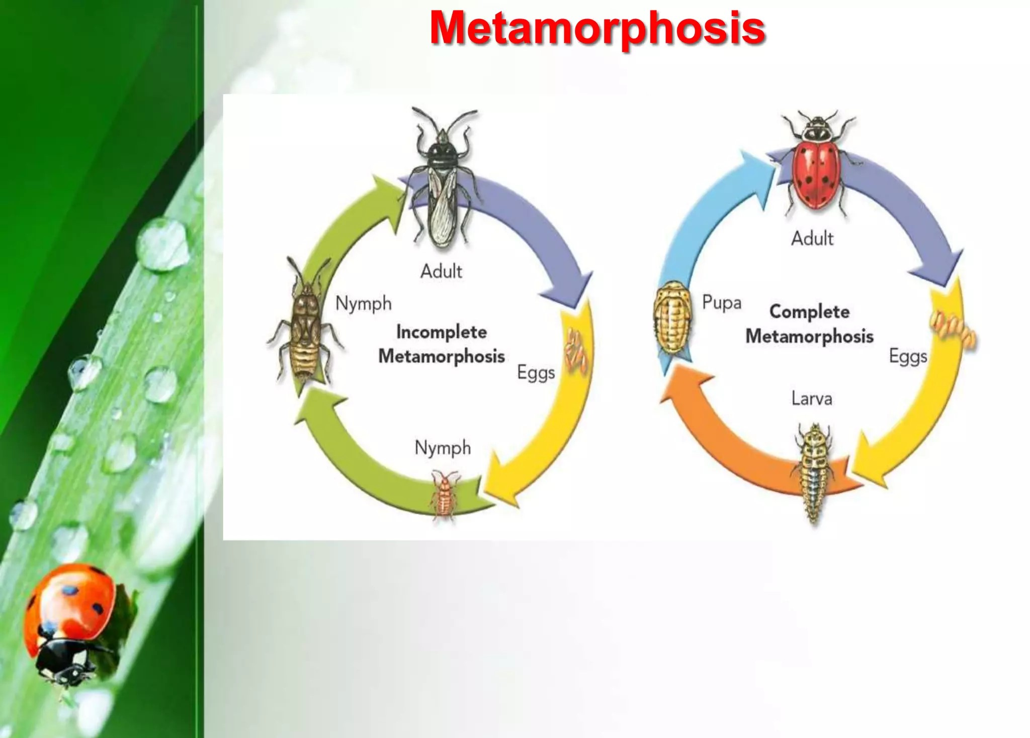

Slide 3
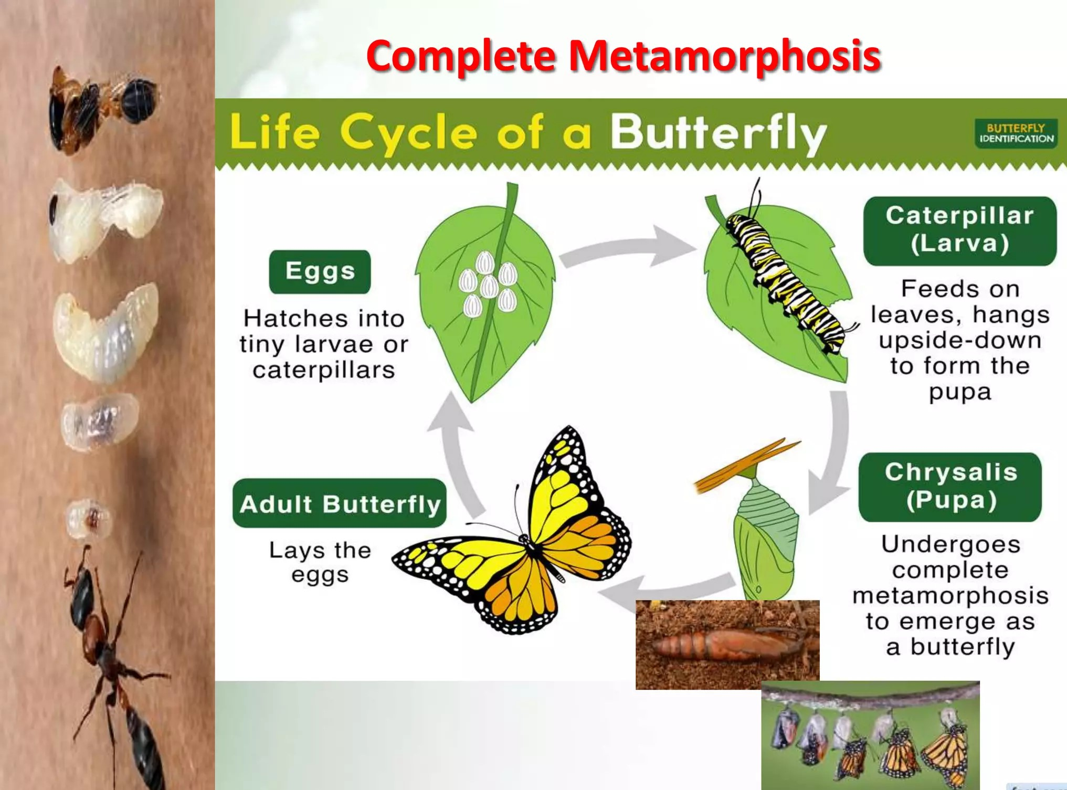

Slide 4
Holometabolous (complete metamorphosis):
In this, four stages in life cycle occur-egg, larva, pupa and adult.
This is characterised by a radical change in form and ecological habits between immature and adults.
For example: butterflies, moths, flies, ants, bees and beetles.
Most of the old body of larva is systematically destroyed by apoptosis, while new adult structures such as legs, wings, structure on head, genitalia and part of changing epidermis develop undifferentiated nests of cells.
Thus, within any larva, there are two distinct populations of cells
i)Larval cells- used for functions of juvenile insect.
ii)Thousands of imaginal cells- lie within larva in clusters, awaiting the signal to differentiate.
Larva (caterpillar, grub, and maggot) undergoes a series of molts as it become larger.
Stages between these larval molts are called instars.
Pupa does not feed and is usually considered as resting stage.
During the pupal stage, the body undergoes a complete reorganisation, transforming into the adult.

Slide 5
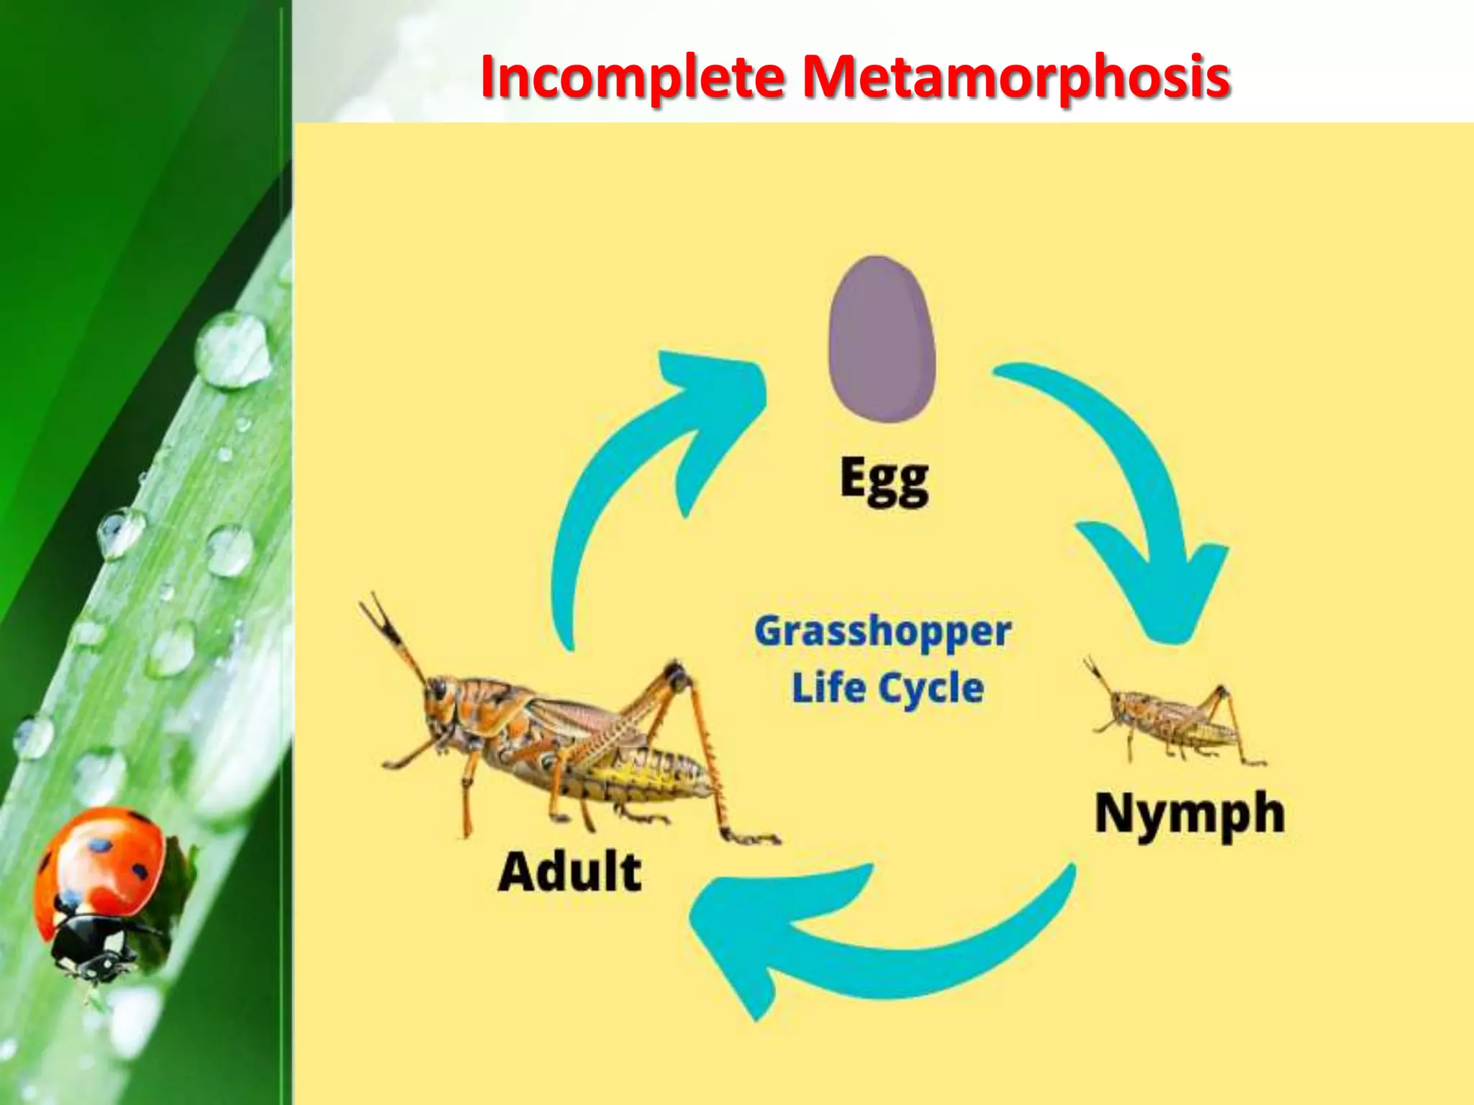

Slide 6
Hemimetabolous (gradual or incomplete metamorphosis):
In this, three life stages occur-egg, nymph and adult.
This type of transformation refers as incomplete metamorphosis.
For example: grasshoppers, mantids, cockroaches, termites, dragonflies and bugs.
Insects hatch from their eggs look like miniature adults. These young insects are called nymph.
After each shedding of skin, nymph enters a new “instar”, a new stage of growth.
Nymph resembles the adult but lacks wings and genitalia.

Slide 7
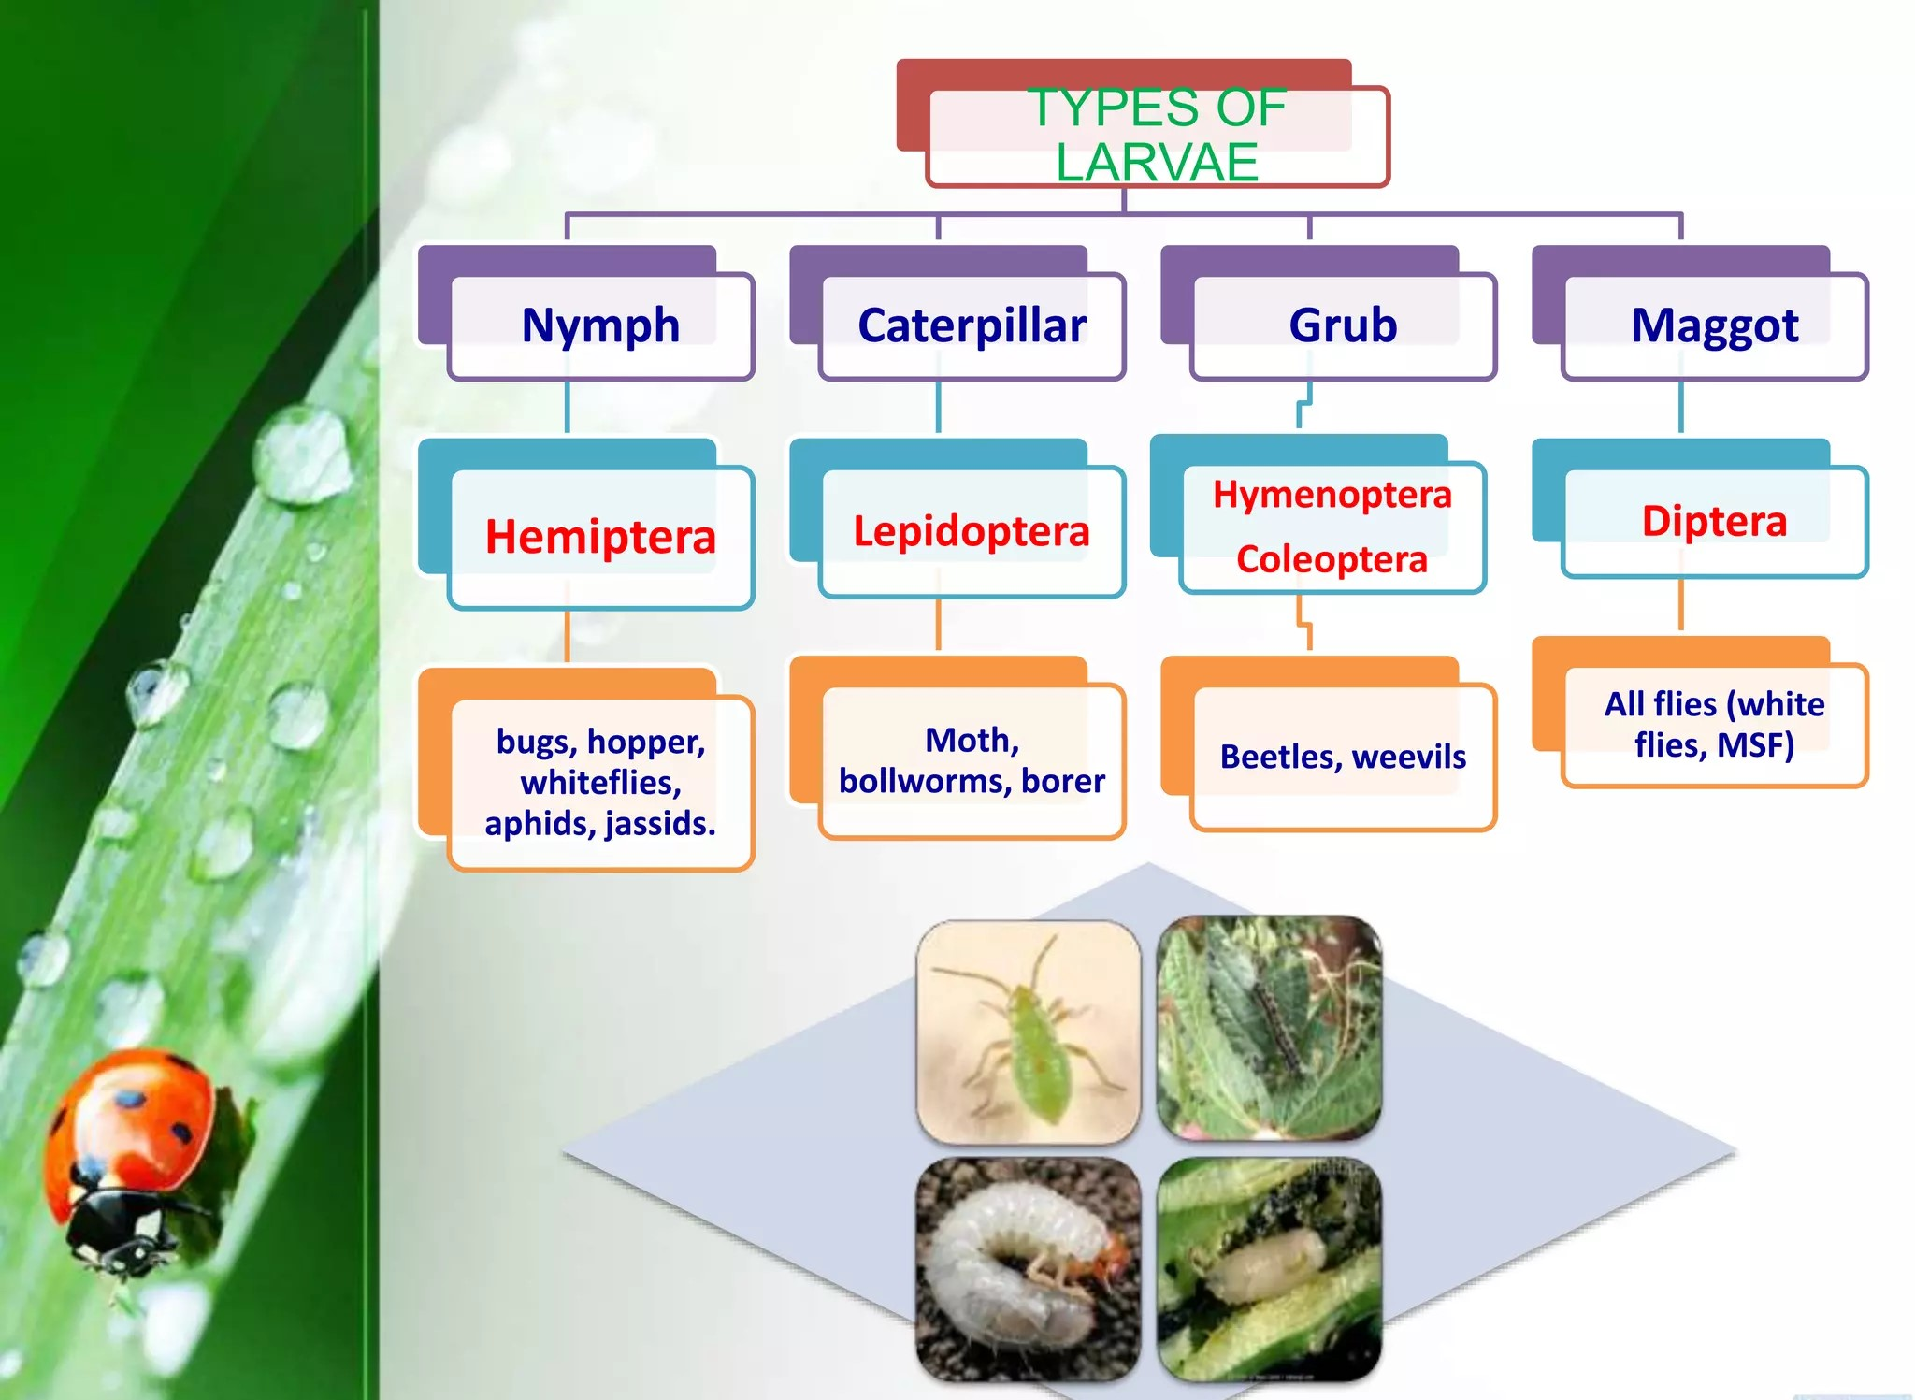

Slide 8
PROCESS OF MOLTING:
Molting, known technically as ecdysis, is literally a period of growth for insects. Insects grow in increments. Each stage of growth ends with molting the process of shedding and replacing the rigid exoskeleton. People often think molting is the simple act of an insect breaking out of its skin and leaving it behind. In truth, the process is complex and involves several parts.
After egg hatches, the immature insect feeds and grows. Its exoskeleton is like a shell. Eventually, the larva or nymph must shed its unyielding overcoat to continue its development. The exoskeleton which serves as its external backbone is used for protection and support. Without an exoskeleton, the insect could not survive. An old exoskeleton is shed when a new one is ready underneath, a process that can take days or weeks.
To undergo the process of molting, an insect must begin to take in air or water by either swallowing it in naturally or raising its internal blood pressure. This instigates the process of molting that begins. The result is a soft, expandable exoskeleton suitable for further growth. This process is repeated several times during the life span of an insect depending on the species. The new exoskeleton will eventually harden and retain the original colouring of the insect as it matures and is exposed to the elements and every day wear-and-tear.

Slide 9
In molting, the epidermis separates from the outermost cuticle. Then, the epidermis forms a protective layer around itself and secretes chemicals that break down the insides of the old cuticle. That protective layer becomes part of the new cuticle. When the epidermis has formed the new cuticle, muscular contractions and air intake cause the insect’s body to swell, thus splitting open the remains of the old cuticle. Finally, the new cuticle hardens.
The insect must continue to swell and expand the new cuticle, so it is large enough to allow room for more growth. The new overcoat is soft and much paler than the former one, but over a few hours, it becomes darker and begins to harden. Within a few days, the insect appears to be a slightly larger copy of its former self.

Slide 10
Hormonal control of Insect metamorphosis
The hormonal control of insect metamorphosis was shown by Wigglesworth (1934), who studied Rhodnius prolixus, a blood-sucking bug that has five instars. When the 1st instar larva of Rhodnius was decapitated and fused with the 5th instar larva, the minute first instar developed the cuticle, body structure, and genitalia of the adult.
Wigglesworth also showed that corpora allata located near the insect brain, produce a hormone that slow down metamorphosis by producing juvenile hormone. This hormone inhibits the genes that promote development of adult characteristics (e.g. wings, reproductive organs, and external genitalia), causing the insect to remain nymph or larva.
The molting process is initiated in the brain, where neurosecretory cells release prothoracicotropic hormone (PTTH) in response to neural, hormonal, or environmental factors. PTTH stimulates the production of ecdysone by the prothoracic glands.
The second major hormone in insect development is juvenile hormone (JH). JH is secreted by corpora allata. The secretory cells of corpora allata are active during larval molts but are inactive during the metamorphic molt. This hormone is responsible for preventing metamorphosis.

Slide 11
When an immature insect has grown sufficiently to require a larger exoskeleton, sensory input from the body activates certain neurosecretory cells in the brain. These neurons respond by secreting brain hormone which stimulates corpora cardiaca to release the prothoracicotropic hormone (PTTH) into circulatory system, which then stimulates the prothoracic glands to secrete the molting hormone, ecdysone.

Slide 12
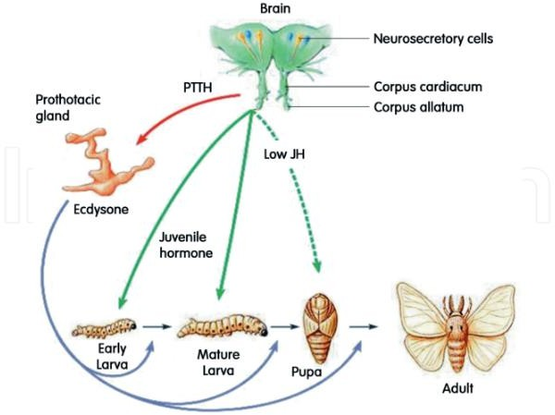
Figure: Hormonal control of insect development.

Slide 13
Mechanism of Hormones :
Juvenile hormone acts as the developmental switch between immature and adult forms, a sesquiterpenoid produced by the corpora allata gland. As long as the juvenile hormone is present in sufficient concentration, promotes the growth of larva, moults result in another larval instar but inhibits the differentiation of adult structures. In the last larval instar, an axonal nerve from the brain inhibits the corpus allatum from releasing juvenile hormone. The lowered JH level allows metamorphosis to continue.
20-hydroxyecdysone (20E) promotes the successive molts, including the metamorphic one, whereas JH is a terpenoids (lipid), which inhibits metamorphosis. 20-hydroxyecdysone initiates and coordinates each molt and regulates the changes in gene expression, induces ecdysis, which mean transfer one stage to another (metamorphosis). Each molt is initiated by one or more pulses of 20-hydroxyecdysone. For a larval molt, the first pulse produces a small rise in the hydroxy ecdysone concentration in the larval hemolymph (blood) and elicits a change in cellular commitment. A second, large pulse of Hydroxy ecdysone initiates the differentiation events associated with molting.
The hydroxyecdysone produced by these pulses commits and stimulates the epidermal cells to synthesize enzymes that digest and recycle the components of the cuticle. Juvenile hormone prevents the ecdysone-induced changes in gene expression (from immature to mature) that means prevents the development of adult characteristics. The presence of juvenile hormone during a molt ensures that the result of that molt produces another instar, not a pupa or an adult.

Slide 14
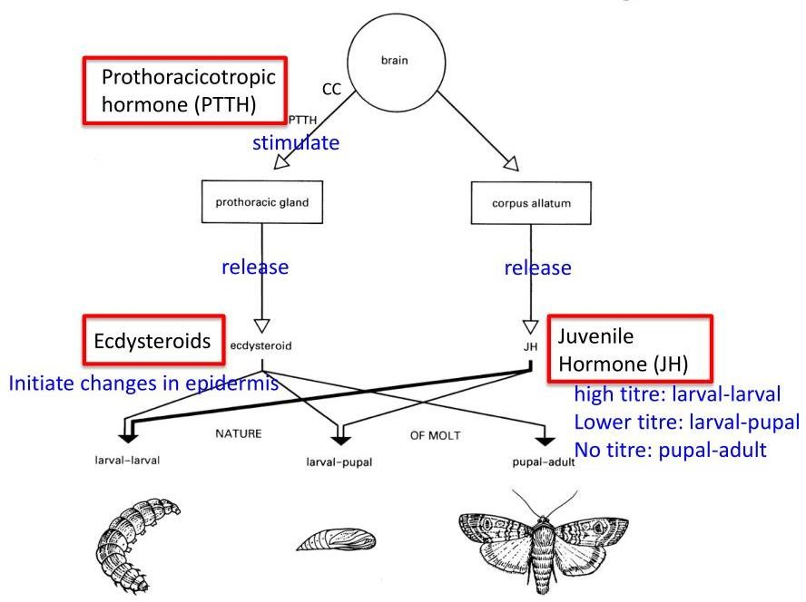

Slide 15
Thank You

