Slide 1

B.A. 5th SEMESTER POLITICAL SCIENCE( MAJOR) Paper Title: WESTERN POLITICAL THOUGHT I Paper Code: PSC MAJ 301-4 Date of Class: 27/08/2025 (WEDNESDAY)

Slide 2
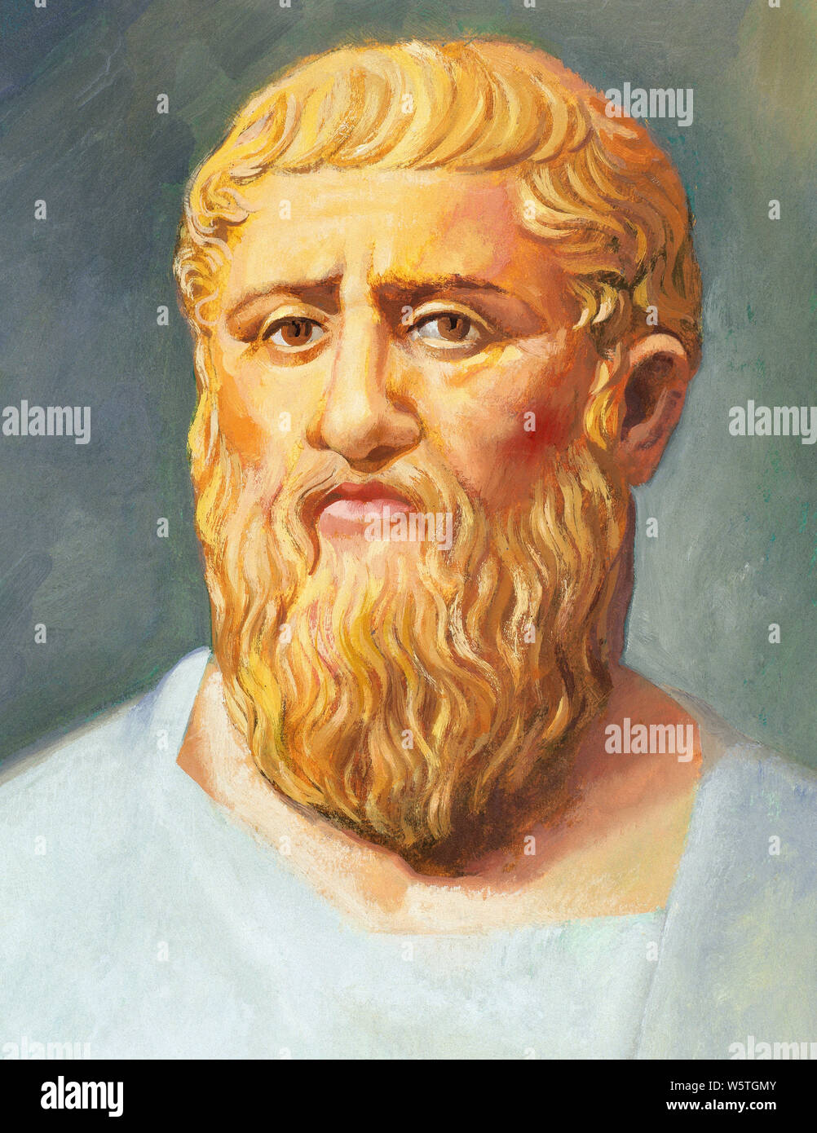
1. Plato (428/427 BCE - 348/347 BCE)

Slide 3
Plato was born around 428/427 BCE and died around 348/347 BCE. He was an ancient Greek philosopher, a student of Socrates, and a teacher of Aristotle. Plato is one of the most important figures in the history of Western philosophy.
Meaning of BCE: BEFORE COMMON ERA/ COMMON ERA
It is used in place of Before Christ(BC)

Slide 4
What Plato Was Famous For? 1. Founding the Academy: Plato founded the Academy in Athens, one of the earliest institutions of higher learning in the Western world, which operated for several centuries. 2. Philosophical Dialogues: Plato is renowned for his written dialogues, where he explores various philosophical concepts through conversations between characters, often featuring Socrates as the main character. Some of his most famous works include "The Republic," "The Symposium," and "Phaedrus.“

Slide 5
Plato's Concept of Philosophy: Definition of Philosophy: Plato views philosophy as the pursuit of wisdom, an endeavor to understand the ultimate truths about existence, reality, and the nature of knowledge. For Plato, philosophy is not merely an intellectual exercise but a way of life, a continuous quest for understanding the eternal forms or ideals that underpin the material world. He believed that the philosopher, by contemplating these forms, especially the Form of the Good, can gain insight into the true nature of justice, beauty, and virtue.

Slide 6
(i) Philosophy as the Pursuit of Wisdom: Plato conceived philosophy as the love of wisdom, a lifelong quest to understand the deepest truths of existence. Unlike the sophists, who were more concerned with rhetoric and persuasion, Plato viewed philosophy as a serious and rigorous discipline aimed at uncovering the underlying realities that govern the world. For him, wisdom was not merely practical knowledge but an understanding of the eternal and unchanging truths that lie beyond the sensory world.
(ii) The Theory of Forms:
Central to Plato’s philosophy is the Theory of Forms, which posits that the material world is only a shadow of a higher, more real world of forms or ideas. These forms are perfect, eternal, and unchangeable, representing the true essence of all things. For example, all physical manifestations of beauty are merely imperfect reflections of the ideal Form of Beauty. Plato believed that true knowledge is the understanding of these forms, rather than the transient and deceptive appearances of the material world.

Slide 7
(iii) The Allegory of the Cave: One of Plato’s most famous contributions to philosophy is the Allegory of the Cave, found in "The Republic." In this allegory, prisoners are chained inside a cave, only able to see shadows projected on the wall by objects behind them. These shadows represent the perceptions of the material world, while the objects casting the shadows symbolize the forms. The journey of the philosopher is likened to a prisoner who escapes the cave and comes to understand that the shadows are mere illusions, with true reality lying in the world outside the cave. This allegory encapsulates Plato’s view that philosophy is a process of moving from ignorance to knowledge, from illusion to truth. (iv) Dialectical Method: Plato employed the dialectical method as a means of philosophical inquiry. This method involves dialogue and the systematic questioning of assumptions to arrive at deeper truths. In his dialogues, Plato often presents Socrates engaging in dialectical exchanges with others, challenging their beliefs and leading them to recognize inconsistencies in their thinking. Through this process, the participants (and the reader) are guided towards a clearer understanding of the forms and the nature of reality. For Plato, the dialectical method is essential to philosophical practice, as it encourages critical thinking and the examination of one's beliefs.

Slide 8
(v) The Role of the Philosopher: Plato believed that philosophers have a unique role in society because of their ability to grasp the forms and, therefore, the true nature of reality. In "The Republic," he argues that only philosophers are fit to rule, as they are the only ones capable of understanding what is truly just and good. The philosopher, in Plato’s view, is not just a thinker but a guide for society, leading others out of the darkness of ignorance and into the light of knowledge. This idea culminates in the concept of the philosopher-king, a ruler who governs not for personal gain but with wisdom and justice, informed by a deep understanding of the forms.
(vi) Philosophy as the Highest Form of Knowledge:
Plato distinguished between different levels of knowledge, placing philosophical knowledge at the highest level. In his epistemology, he contrasts doxa (opinion) with episteme (knowledge). Doxa pertains to beliefs about the sensory world, which are often flawed and unreliable. Episteme, on the other hand, is knowledge of the forms, which is certain and unchanging. Plato believed that most people live their lives based on doxa, while philosophers, through their study of the forms, achieve episteme. This higher knowledge enables philosophers to understand the true nature of reality, making them the most qualified to lead and instruct others.

Slide 9
(vii) The Immortality of the Soul: Plato's concept of philosophy is closely tied to his views on the soul. He believed that the soul is immortal and exists before and after its union with the body. In dialogues such as "Phaedo," Plato argues that the soul's ability to understand the forms is evidence of its immortality. Since the forms are eternal, the soul must also be eternal to apprehend them. This belief in the soul’s immortality underlies Plato’s view that philosophy is a process of recollection, where the soul remembers the forms it knew before its incarnation in the physical world. Thus, the philosopher’s quest for knowledge is seen as a journey of the soul back to its original state of purity and understanding. (viii) Philosophy as Preparation for Death: In connection with his belief in the immortality of the soul, Plato viewed philosophy as a preparation for death. He argued that the philosopher, through the pursuit of wisdom, detaches from the desires and distractions of the material world and focuses on the eternal truths of the forms. This detachment prepares the soul for its eventual release from the body at death, allowing it to return to the realm of the forms. In "Phaedo," Plato describes philosophy as a practice of dying, where the philosopher learns to separate the soul from the body’s influence, achieving a state of purity and readiness for the afterlife.

Slide 10
(ix) The Unity of Virtue and Knowledge: Plato believed that knowledge and virtue are inseparable. He argued that to know the good is to do the good, and that all wrongdoing is the result of ignorance. This is because, in Plato’s view, true knowledge leads to an understanding of the forms, particularly the Form of the Good, which is the highest form and the source of all value. Once a person understands the good, they will naturally act in accordance with it, as they recognize that it leads to true happiness and fulfillment. Thus, for Plato, philosophy is not just an intellectual pursuit but a moral one, aimed at cultivating virtue and guiding people toward a just and good life. (x) The Ascent to the Good: The ultimate goal of philosophy, according to Plato, is the ascent to the Good. In "The Republic," he describes the Form of the Good as the highest reality, beyond even being, and the source of all other forms. The Good is what gives meaning and purpose to everything else, and it is the final object of the philosopher’s quest. Plato compares the Good to the sun, which illuminates the world and makes knowledge possible. The philosopher’s journey, then, is a gradual ascent from the darkness of ignorance to the light of the Good, where one achieves the highest form of knowledge and understanding. This ascent is both an intellectual and spiritual journey, culminating in a profound connection with the ultimate reality.

Slide 11
Conclusion: Plato's concept of philosophy is a comprehensive and profound exploration of the nature of knowledge, reality, and the human soul. Through the ten points discussed, it is clear that for Plato, philosophy is much more than an academic discipline; it is a way of life, a pursuit of the highest truths, and a preparation for the soul's ultimate journey. His ideas continue to influence and inspire, offering a vision of philosophy that challenges us to seek wisdom, cultivate virtue, and strive for a deeper understanding of the world and ourselves.

Slide 12
THANK U !

